Slide 1
CTM 1A
Sections 14.1 – 14.2 Simplifying, Multiplying and Dividing Rational Expressions

Slide 2
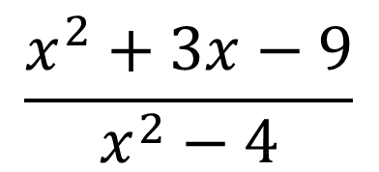
Rational Expressions
A rational expression is an algebraic fraction in which the numerator, denominator or both are polynomials.
$$\frac{x^{2}+3x−9}{x^{2}−4}$$

Slide 3
Rational Expressions
Rational expressions are fractions. Therefore to simplify, add, subtract, multiply or divide rational expressions we will use the same algorithms as we used with fractions.

Slide 4
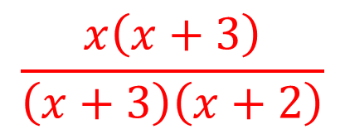
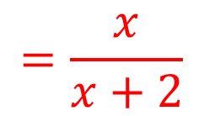
Rational Expressions
Simplify each rational expression. (Examples)
$$a) \frac{x\left(x+3\right)}{\left(x+3\right)\left(x+2\right)}$$
$$\frac{x\left(x+3\right)}{\left(x+3\right)\left(x+2\right)}$$
$$=\frac{x}{x+2}$$

Slide 5
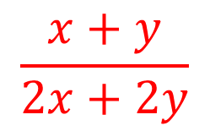
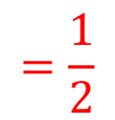
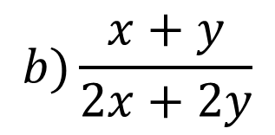
Rational Expressions
Simplify each rational expression. (Examples)
$$b)\frac{x+y}{2x+2y}$$
$$\frac{x+y}{2x+2y}$$
$$1(x+y)$$
$$=\frac{1}{2}$$
$$=$$
$$2(x+y)$$

Slide 6
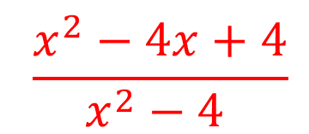
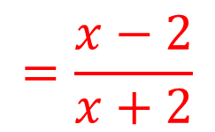
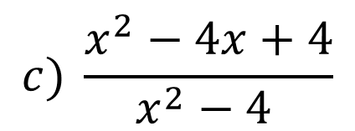
Rational Expressions
Simplify each rational expression. (Examples)
$$c) \frac{x^{2}−4x+4}{x^{2}−4 }$$
$$\frac{x^{2}−4x+4}{x^{2}−4 }$$
$$(x−2)(x−2)$$
$$=\frac{x−2}{x+2}$$
$$=$$
$$(x−2)(x+2)$$

Slide 7
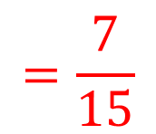
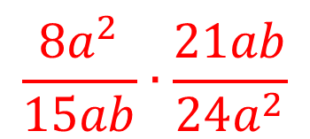
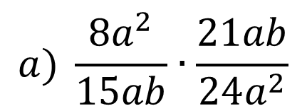
Rational Expressions
Multiply or divide. Reduce to simplest form. (Examples)
$$a) \frac{8a^{2}}{15ab}∙\frac{21ab}{24a^{2}}$$
$$1$$
$$7$$
$$\frac{8a^{2}}{15ab}∙\frac{21ab}{24a^{2}}$$
$$=\frac{7}{15}$$
$$5$$
$$3$$

Slide 8
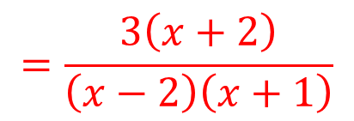
Rational Expressions
Multiply or divide. Reduce to simplest form. (Examples)
$$b)\frac{x^{2}−5x−14}{x^{2}−x−2}∙\frac{3x+3}{x^{2}−6x−7}$$
$$\frac{x^{2}−5x−14}{x^{2}−x−2}∙\frac{3x+3}{x^{2}−6x−7}$$
$$(x−7)(x+2)$$
$$3(x+1)$$
$$=$$
$$∙$$
$$(x−2)(x+1)$$
$$(x−7)(x+1)$$
$$=\frac{3\left(x+2\right)}{\left(x−2\right)\left(x+1\right)}$$

Slide 9
Rational Expressions
Multiply or divide. Reduce to simplest form. (Examples)
$$c)\frac{x^{2}−9}{x^{2}−4x+4}÷\frac{x+3 }{x−2}$$
$$\frac{x^{2}−9}{x^{2}−4x+4}÷\frac{x+3 }{x−2}$$
$$=\frac{x^{2}−9}{x^{2}−4x+4}∙\frac{x−2}{x+3}$$
$$=\frac{(x−3)(x+3)}{(x−2)(x−2)}∙\frac{(x−2)}{(x+3)}$$

Slide 10
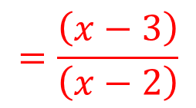
Rational Expressions
Multiply or divide. Reduce to simplest form. (Examples)
$$c)\frac{x^{2}−9}{x^{2}−4x+4}÷\frac{x+3 }{x−2}$$
$$\frac{x^{2}−9}{x^{2}−4x+4}÷\frac{x+3 }{x−2}$$
$$=\frac{(x−3)(x+3)}{(x−2)(x−2)}∙\frac{(x−2)}{(x+3)}$$
$$=\frac{\left(x−3\right)}{\left(x−2\right)}$$

Slide 11
Rational Expressions
Simplify each rational expression. (Skill Check)
$$a) \frac{3x^{2}(2x−1)}{x^{3}(2x−1)} \frac{3}{x}$$
$$b)\frac{a+b}{a^{2}−b^{2}} \frac{1}{a−b}$$

Slide 12
Rational Expressions
Simplify each rational expression. (Skill Check)
$$c) \frac{4x^{2}−16}{6x+12} \frac{2(x−2)}{3}$$
$$d)\frac{x^{2}−3x−10}{−x^{2}−3x−2} −\frac{x−5}{x+1}$$

Slide 13
Rational Expressions
Multiply or divide. Reduce to simplest form. (Skill Check)
$$a) \frac{15x^{2}y}{8xy^{2}}∙\frac{20y}{25x} \frac{3}{2}$$
$$b)\frac{x^{2}+2x+1}{5x−5}∙\frac{15}{x^{2}+3x+2} \frac{3\left(x+1\right)}{\left(x−3\right)\left(x+2\right)}$$

Slide 14
Rational Expressions
Multiply or divide. Reduce to simplest form. (Skill Check)
$$c) \frac{7a^{2}b}{15b}÷\frac{14a}{9b} \frac{3ab}{10}$$
$$d)\frac{x^{2}−5x+6}{x^{2}−9}÷\frac{4x+8}{x^{2}+5x+6} \frac{x−2}{4}$$

Slide 15
Rational Expressions
Multiply or divide. Reduce to simplest form. (Skill Check)
$$e) \frac{\frac{2x−6}{1−x}}{\frac{x^{2}−2x−3}{x^{2}−1}} −2$$

